Slide 1
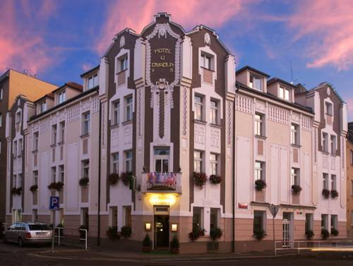
Special offert
3 nights in Praga
4-star hotel,
breakfast included
return flight
Hotel U Divadla
126 euro

