Slide 1
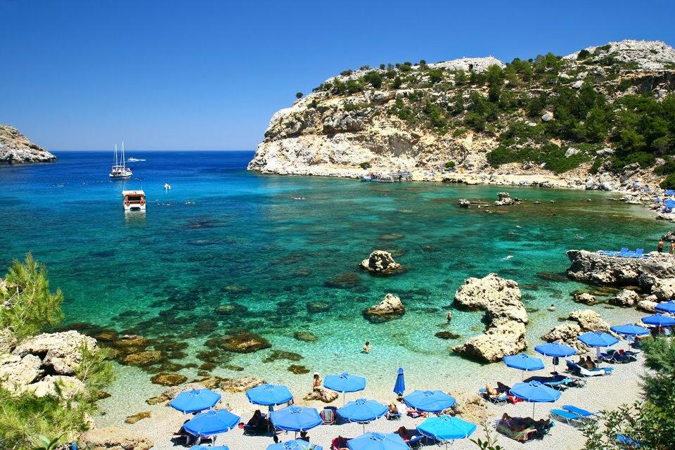
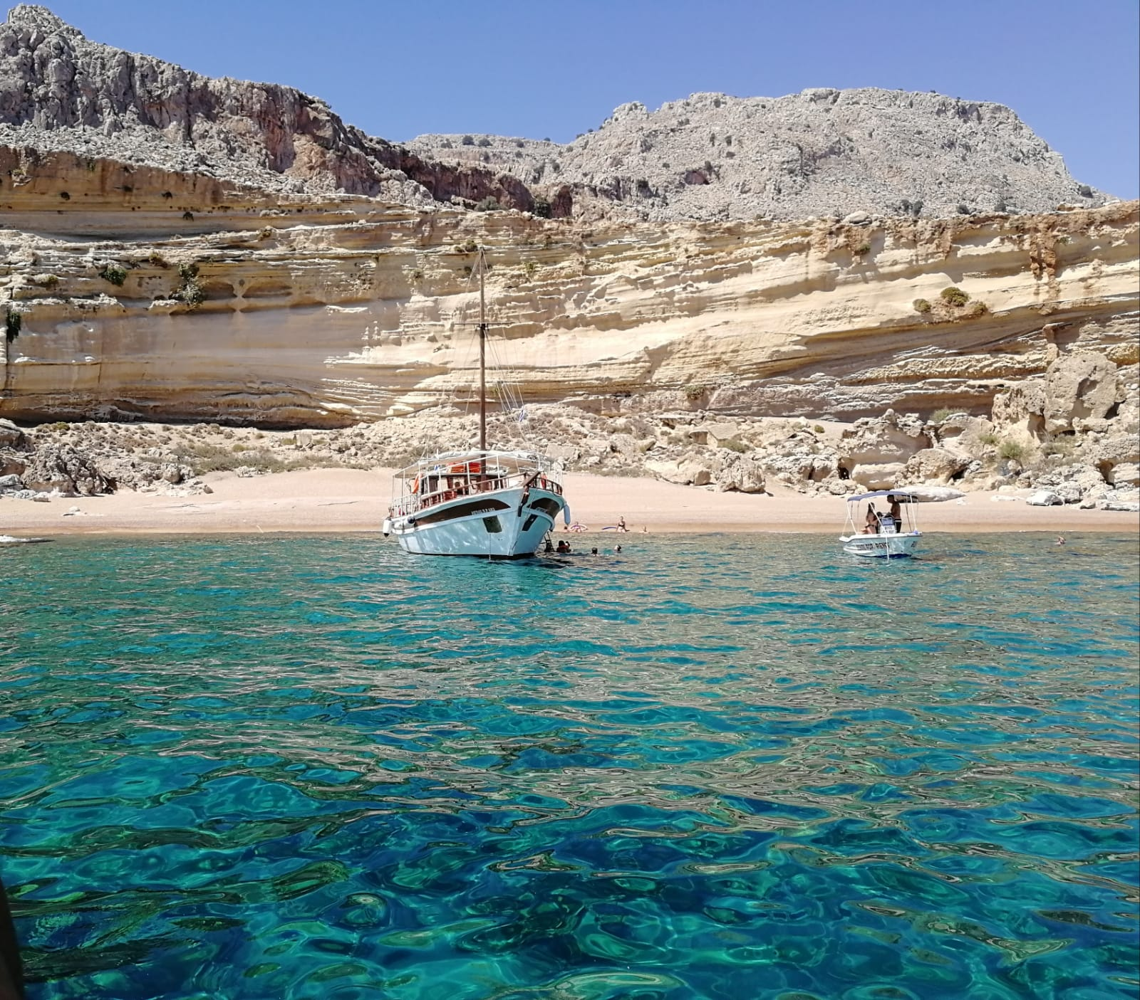
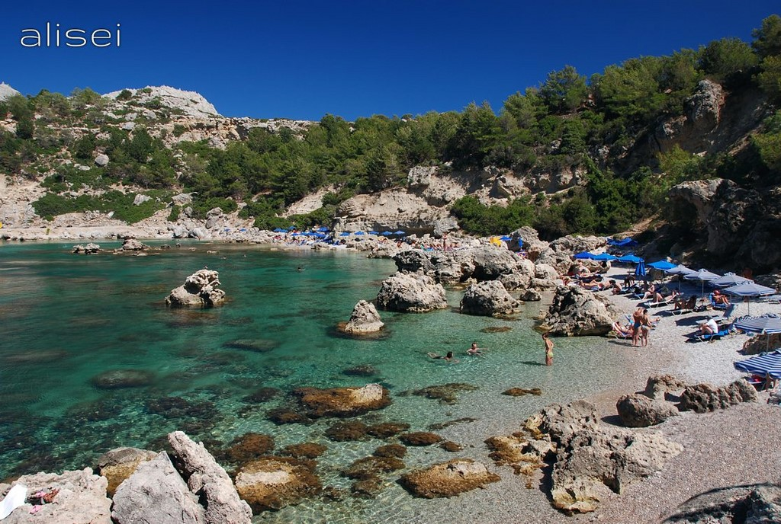
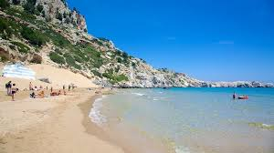
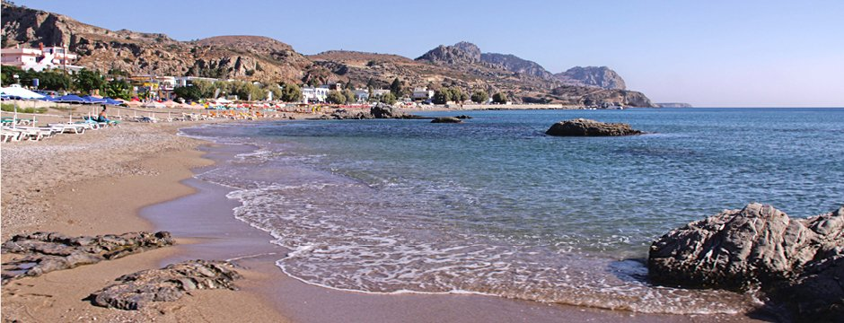
KIVOTOS
TOU PANORMITI
Anthony quinn
Red sand beach
mini and daily cruises
special offers
only 12 people
45 EURO
Ladiko
Stegna beach
Tsambika beach

